Slide 1
Quarterly Macro-Fiscal Outlook
Summary Forecast 2023-26
June 2, 2023 (rev. structure Aug.2023)

Slide 2
Rationale Outlook and underlying model
Provide forecast for 16 quarters ahead for key macro variables (output, inflation, final demands, ...) as influenced by fiscal, monetary, and exchange rate policies, including in response to shocks and new developments
Provide alternative policy scenarios and suggest policy implications
Provide input to, and complement, other projections
Tool: Quarterly Macro Fiscal Model, a so-called “gap” model:
special emphasis on fiscal deficit and components (rev, exp, oexp; struct, discr, cycl)
tracing macro variables in deviation from trends, potential levels, or targets
after shocks and policy responses, variables return to their trends
trends converge to steady states (outside model), e.g., potential output growth, real interest and exchange rates, sustainable deficit, and target inflation….

Slide 3
1. Recent macroeconomic developments (2019-23) new
Background
analysis of trends and policy stance
focus on fiscal policies as captured in model
output/final demands and inflation

Slide 4
2. Current policy stance/initial condition new

Slide 5
3. Forecast assumptions slightly revised
The forecasts are conditional on exogenous and judgemental assumptions:
external environment (foreign prices, demand, food/oil prices, interest rates, )
domestic trends and gaps distilled from historic data (quarterly 2006-23)
domestic near-term forecasts (now/forecast GDP, latest CPI, judgements…)
domestic known or expected policies (e.g., fiscal and interest rate) and
assumptions on continuation of recent shocks (e.g., in agriculture, core inflation)
Notes:
The QMFM model is originated or derived from a canonical-new Keynesian reduced form model (log-linearized equations of a micro-founded model)

Slide 6
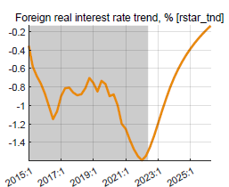
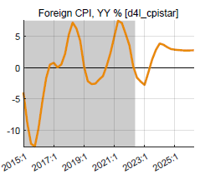
External environment
World economy slowing down as interest rates are raised in response to inflation
Rwanda still enjoys recovery in trading partner demand relative to Covid-years, at 3% p.y., well above trend
World real interest rates are projected to increase from negative in the past decade to close to zero in the near term, and latest WEO foresees around 1% for MT
Trading partners’ CPI (in US$) was subdued at 1.5% py in past 5-7 years
Projected to return to more normal level of 3% in coming years

Slide 7
Domestic environment
Current fiscal, monetary, and exchange rate policies (in part “tuned”):
Fiscal tightening under 2022/23—2023/24 Budgets, with phasing out of Covid and Ukraine-crises spending, and temporary sharp reduction in fiscal deficit & impulse, with deficit increasing back to ‘normal’ from 2024?25
Maintenance of current level of policy interest rate (interbank rate)
Somewhat faster exchange rate depreciation in 2023 (than 2022), targeted in PCI
Expected return to normal of agricultural harvests and domestic food prices
Notes:
Isssue temporary sharp deficit reduction creating volatility in output gap and inflation (and RIR, RER)

Slide 8
4. Summary of macroeconomic forecast new
Table with key macroeconomic indicators
Bullet highlights
A few charts
Notes:
Isssue temporary sharp deficit reduction creating volatility in output gap and inflation (and RIR, RER)

Slide 9
5. Macroeconomic forecast narrative
Macroeconomic aggregates and their key components and drivers:
Output growth and cyclical position
Private demand and cyclical position
Government demand and deficit, structural, cyclical and discretionary components
Inflation and components
Nominal and real interest rates
Nominal and real exchange rates
Notes:
Isssue temporary sharp deficit reduction creating volatility in output gap and inflation (and RIR, RER)

Slide 10
Forecast—Output and cyclical position (GDP growth)
Output growth: to rise a bit above trend in 2023-24, completing post-Covid recovery
Driven by:
consumption recovering from Covid shocks, helped by below-trend RIR
exports recovering from Covid shocks though hampered by still below-trend RER
govt spending dropped in FY 2022/23 (incl. ending Covid- and Ukraine-crises spending)
further govt tightening in FY2023/24, before returning to ‘normal’ (cf. Fiscal Impulse below)
output back to trend of 7.5 % p.y. from 2025

Slide 11
Forecast—cyclical total demand driving GDP
GDP below potential: gap is estimated at 4 % at end-2022
Output (GDP) to return to its potential level by 2025, i.e., GDP if growth had continued at pre-Covid trend rate
Driven by:
disappearing Covid down-pull from consumption and exports, which are forecast to return to normal
exports recovering from Covid-related shocks and helped by increasing RER
govt demand—pulled up output under Covid—goes ‘in reverse’ in 2022/23-20243/24, before picking up thereafter

Slide 12
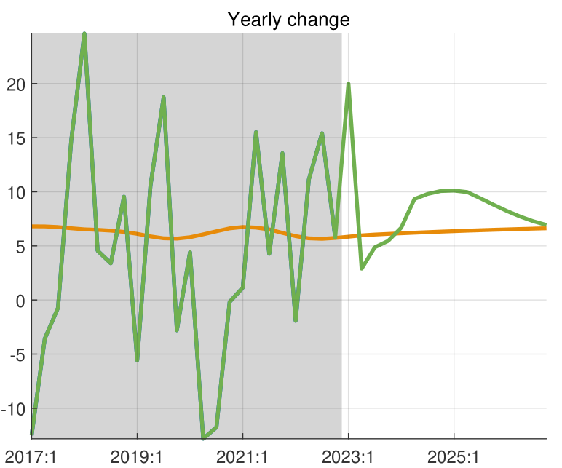
Private consumption and cyclical position
Consumption gap:
key driver of 2020-21 negative output gap (+75 % of GDP)
Covid negative shocks (persistence) forecast to end in 2023
fiscal impulse helped offset somewhat negative consumption shocks during Covid, but oxen it is ending in 2023
Consumption growth:
continued recovery from Covid, with higher than trend growth in 2023-24
returns to its trend growth from 2025
Notes:
We tuned GDP down in 2023Q1 (nowcast), and tuned cons down too (shock)

Slide 13
Private investment and cyclical position new
Notes:
We tuned GDP down in 2023Q1 (nowcast), and tuned cons down too (shock)

Slide 14
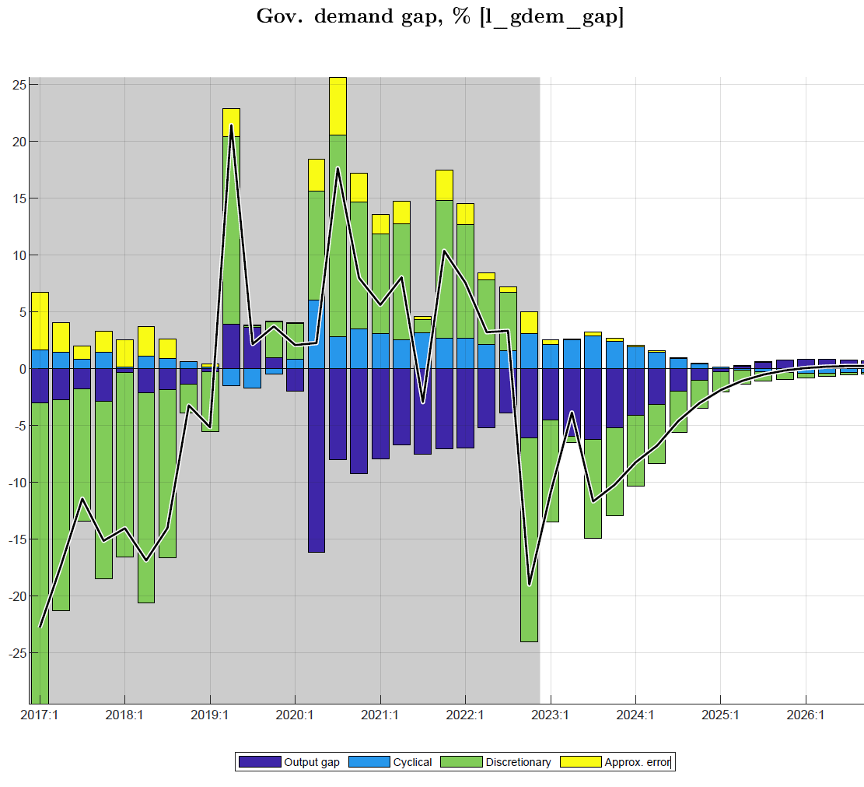
Fiscal stance (i): govt demand for G&S affects output directly
Fiscal policies (“fiscal stance”) affect output in the short-run via several channels captured in the model:
govt demand for G&S affects final demand and output directly
discretionary deficit plus change in structural deficit (defined as “fiscal impulse”) affect private demand and output indirectly
cyclical deficit—automatic higher spending and lower revenue in downturn (and vice versa)—affects output automatically
Government demand for G&S (direct) (+ 23% of GDP):
mainly exogenous (discretionary spending)
some anti-cyclical spending (e.g., transfers) kicks in under downturn, esp. in Covid episode
under Covid, high govt demand helped offset negative output gap, with positive impact estimated at 1½ % of GDP
in 2022/23 and 2023/24, sharp tightening in govt demand with reverse negative impact on output gap
Notes:
See Output gap and Fiscal Impulse in last Chart

Slide 15
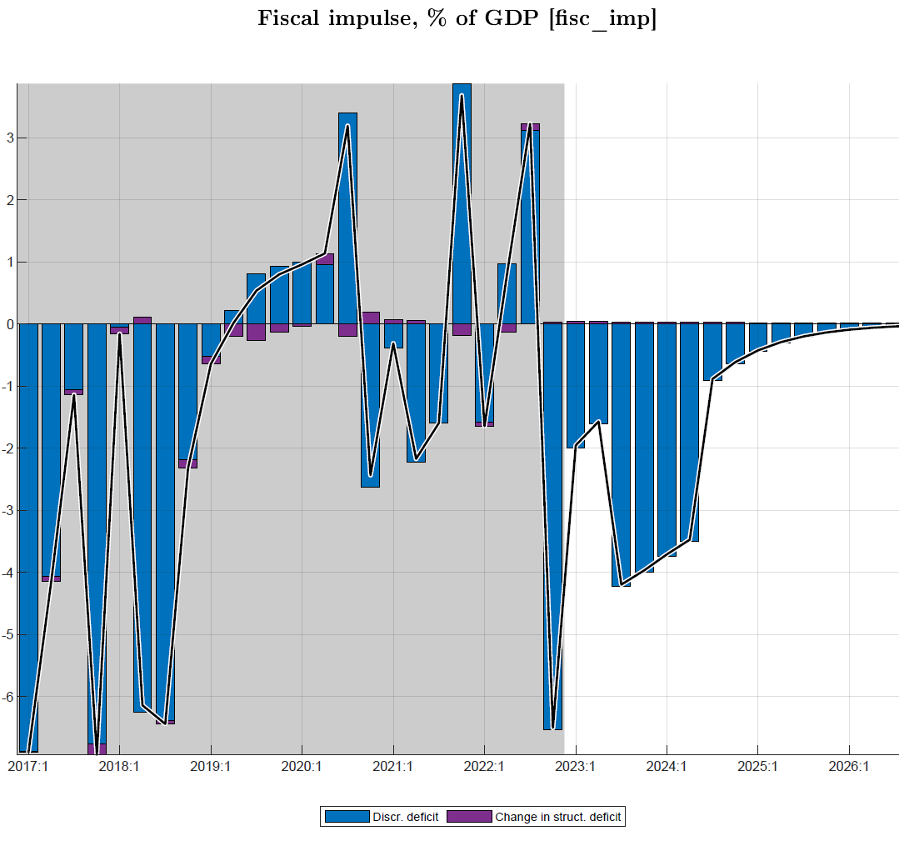
Fiscal stance (ii): fiscal impulse affects output via private demand
‘Fiscal impulse’ (indirect):
defined as discretionary deficit plus change in structural deficit (in % GDP), mainly reflects discretionary spending (demand for G&S, transfers/subsidies etc.)
There was large positive fiscal impulse in only a few quarters during 2020-22, and relatively small on average over the period
affects private consumption and investment via income effect and “confidence factor”
the fiscal impulse effect on private demand and hence output during Covid years is estimated at about ½ % of GDP, but should have reverse effect on private demand in 2022/23-2023/24
Notes:
In more aggregate models, “fiscal impulse” comprises both direct effect of govt spending on G&S and the indirect effect via private consumption and investment (affected by transfers/subsidies and reduced effective revenue collection)

Slide 16
Fiscal stance: govt demand and ‘fiscal impulse’─estimated effect on output
Combined effect: offsetting output gap during Covid, reverse impact due to ongoing tightening thereafter
discretionary govt demand (G&S) affects output directly (after imports)
during COVID, govt demand of 2 % of GDP on average increased output by almost 1.5 % of GDP
‘fiscal impulse’ in % of GDP” affected output indirectly via private demand by almost ½ % of GDP
reverse impact is expected from the fiscal tightening under PCI from 2022/23 on
Notes:
Optional illustration of fiscal impulse in relation to output/gap

Slide 17
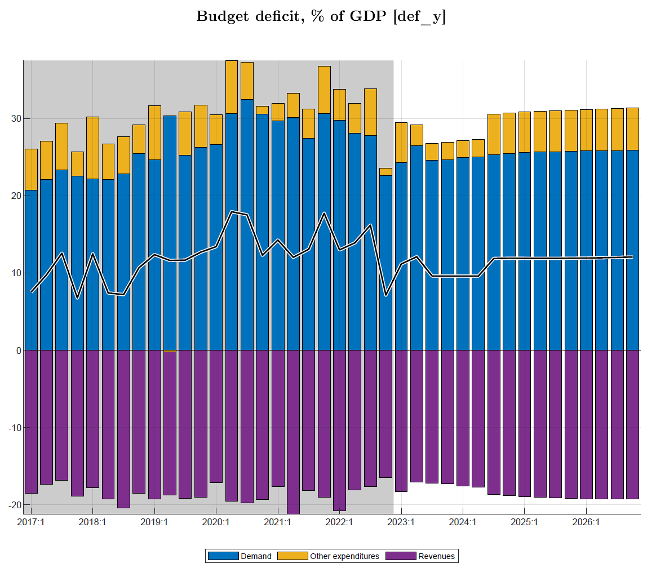
Fiscal stance: deficit and its components (revenue, spending)
Deficit (excl. grants) forecast to tighten + 2 % points of GDP below pre-Covid and sustainable level in 2022/23─2023/24, as program fast-tracks debt/GDP reduction, then to sustainable level thereafter
Deficit (components) tuned with near-term program
large spending cuts compared to Covid and even pre-Covid for four years from 2023/24
also, needed to offset temporary revenue shortfalls of around 1% of GDP levels in 2023/24-2024/25
deficits dips well below sustainable levels for several years, thus bringing down fast debt/GDP ratios that rose during Covid (esp. from IMF lending)
sustainable deficit: derived grants (+4.5% of GDP) and net borrowing consistent with debt/GDP of 75% (65% in NPV, 10% domestic, 15% grant element, …)
Notes:
Optional illustration of fiscal impulse in relation to output/gap

Slide 18
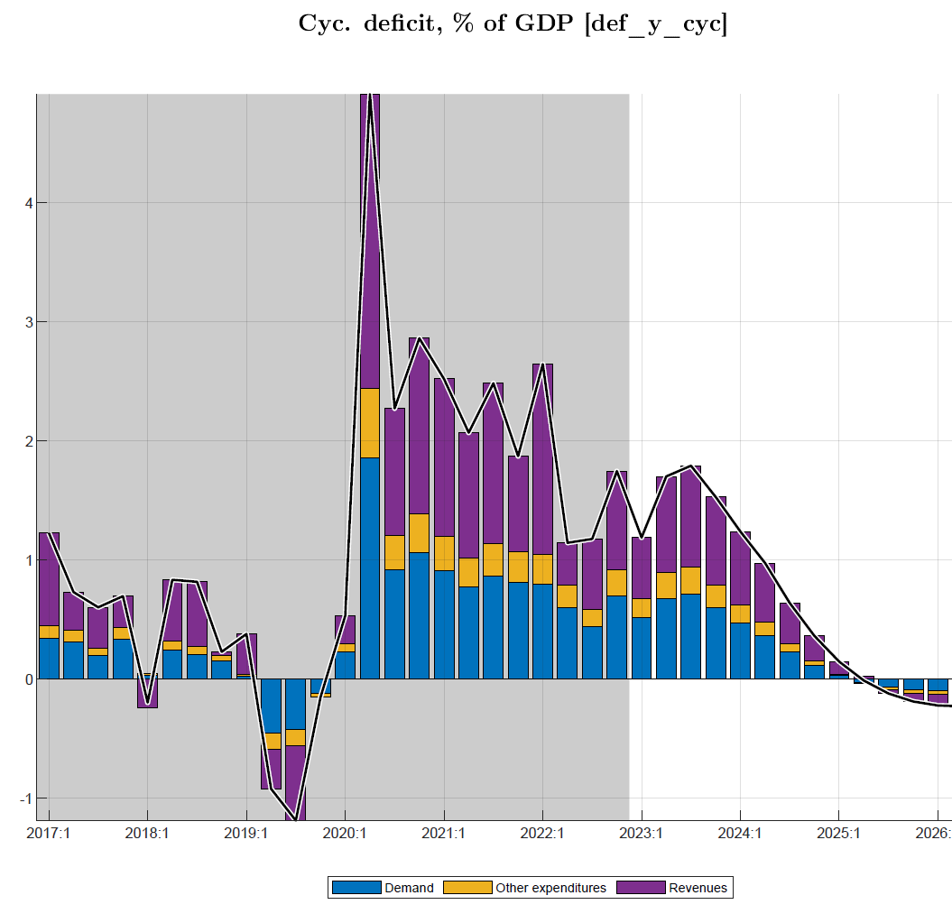
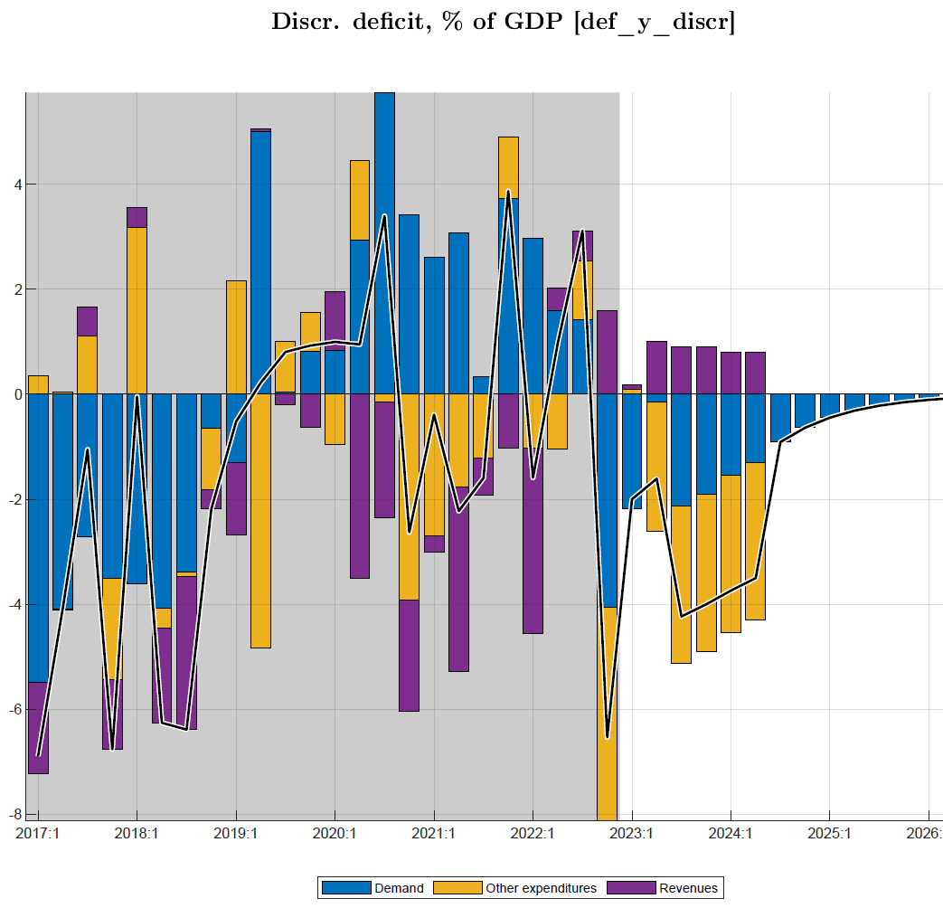
Fiscal stance: deficit and its components (discretionary, cyclical, structural)
Deficit discretionary & cyclical components forecast (w. near-term program), phasing out gradually
reductions in discretionary (demand G&S, other..) spending
losses in (non-tax), revenue, are gradually being offset
Cyclical deficit components phase out as output gap goes to zero
Notes:
Optional illustration of fiscal impulse in relation to output/gap

Slide 19
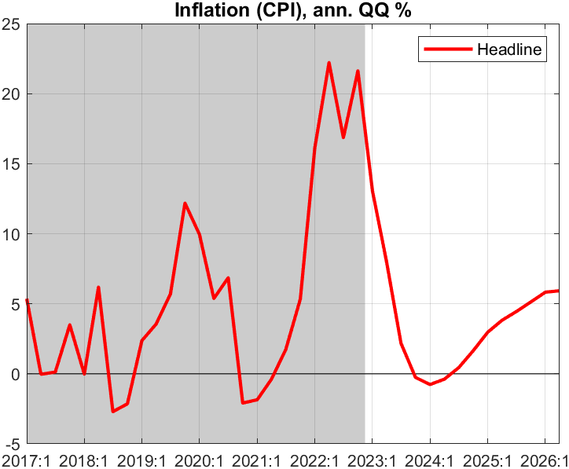
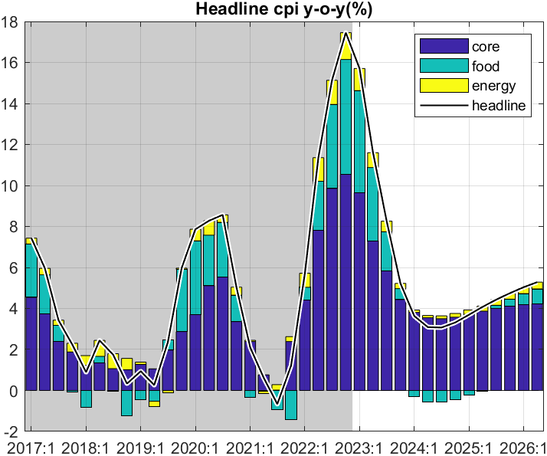
Forecast—Inflation outlook (overview)
decline in q-on-q inflation translates into less fast drop in y-on-y inflation, estimated to peak in Q4 2022 and dropping to below 5% in Q1 2024
all components drop, while drop in food prices contributes most
Headline CPI components
q-on-q annualized inflation is forecast to decline gradually in 2023 after peak in Q2 2022
predicated on recent shocks abating and inflation expectations being countered by NBR action and fiscal restraint
Notes:
Rationale of relative (food, energy) and therefore relative core price
Main message inflation: easing from interest rate and fiscal tightening (and abating shocks); reverse tightening of govt increases demand, output and a temporary above target inflation

Slide 20
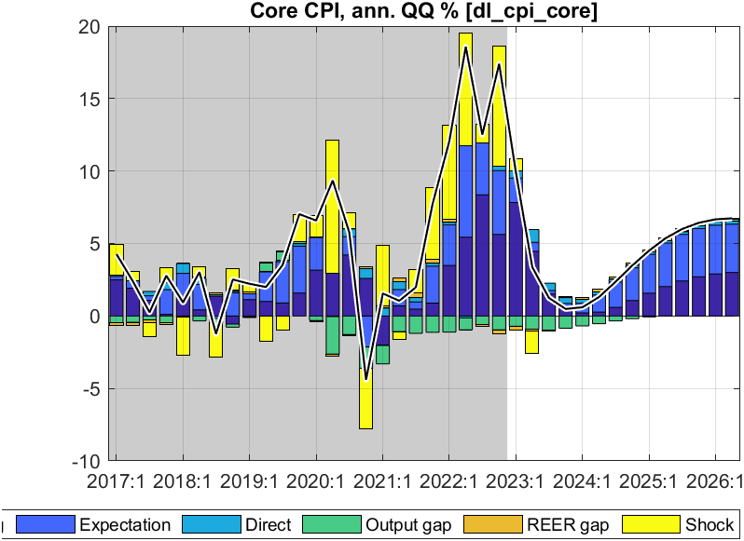
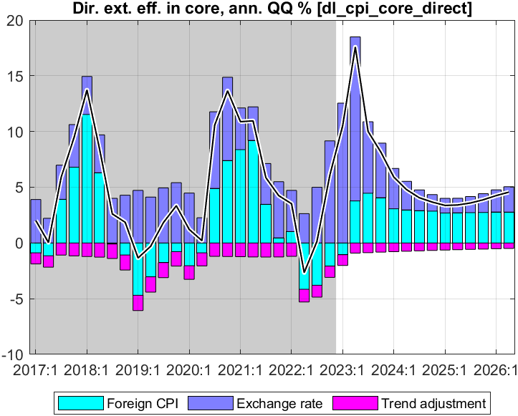
Forecast—Core inflation (q-on-q annualized)
Direct effect foreign import prices and ER on CPI core:
foreign prices continue declining for most of 2023-26
ER depreciation raises RWF prices, but net direct effect is small
CPI core down from peak 2022 Q4; main drivers:
down-pull effect from remaining output gap disappearing
strong effect of expectations and persistence
no direct effect of import prices as ~ constant in RWF terms

Slide 21
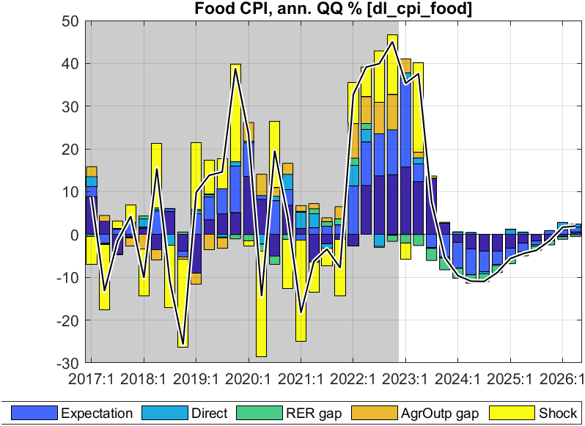
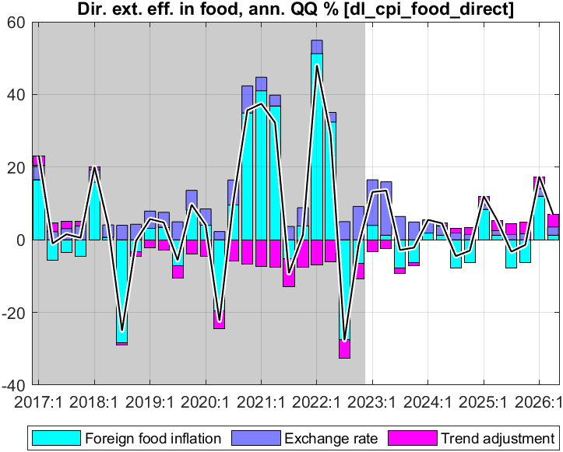
Forecast—Food inflation (q-on-q annualized)
Direct effect of foreign prices and ER on food CPI
foreign food prices continue declining for most of 2023-26
ER depreciation raises RWF prices but net direct effect is small
CPI food down from peak in 2022 Q4; main drivers:
agricultural output is forecast to normalize
imported food prices projected to continue declining
small offsetting effect of lessening RER overvaluation (faster depr.)
Notes:
Direct effect small as import share small for country (larger for urban)

Slide 22
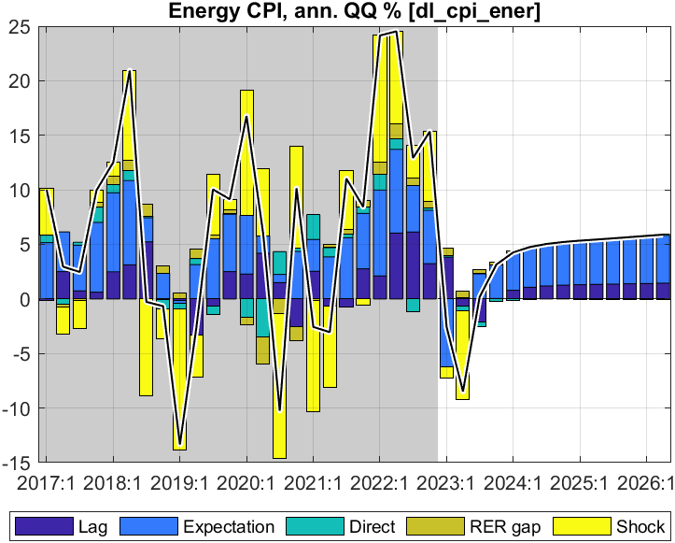
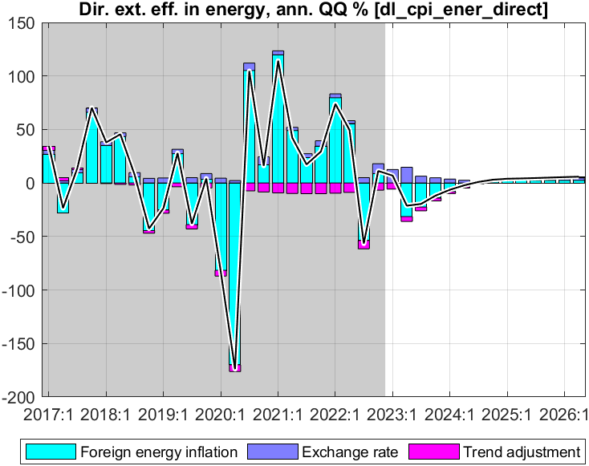
Forecast—Energy inflation (q-on-q annualized)
Direct effect foreign import prices and ER on energy CPI:
foreign energy prices continue declining for most of 2023-26
ER depreciation raises RWF prices, but net direct effect is small
CPI energy down from peak in 2022 Q2; main drivers:
imported energy prices projected to continue declining
small offsetting effect of lessening RER overvaluation (faster depr.)

Slide 23
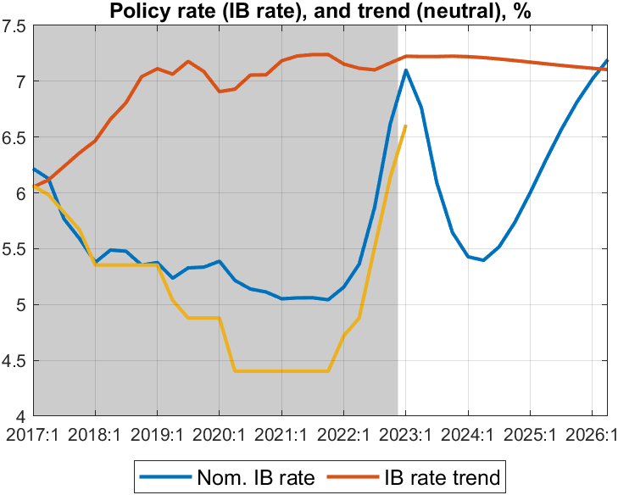
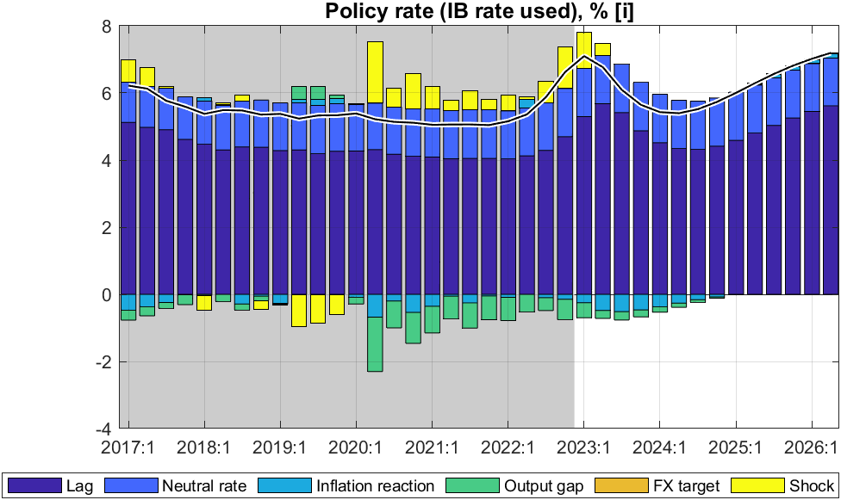
Forecast—Policy interest rate (interbank rate, IB)
Policy rate (IB) driven by rule:
responding to both inflation deviation (from 5% target) and the output gap
gradual interest rate changes (lagged effect)
pulled to ‘neutral’ rate of 7% (foreign real rate, country risk, core inflation)
Policy rate (IB) influenced by NBR with its CBR:
IB followed closely the 2% points CBR increases in 2022,, enacted to combat inflation
IB forecast to go down after peak in Q1 2023 given falling inflation and still high and rising output gap
from 2024, back to trend driven by a ‘neutral’ rate of almost 7%
increased policy rate should raise RIR and stem demand
Notes:
Why is IB not 7.4 in Q1 2023? We must convert back i= log(1+IB). Maybe need some IB smoothing, with lower drop in face of negative outputgap from govt demand?

Slide 24
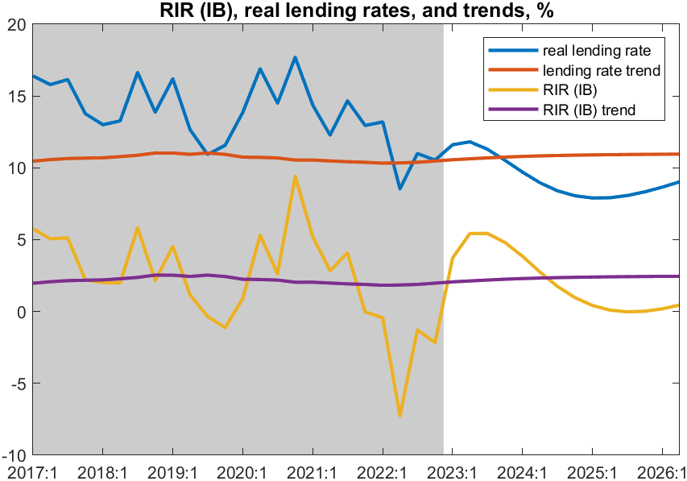
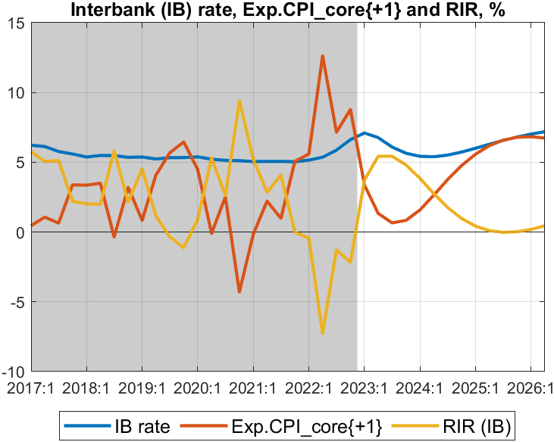
Forecast—Real interest rate (RIR) (policy and lending rates)
RIR policy rate (IB) components:
after sharp drop due to inflation surge in 2022, RIR starts rising from mid-2022 as policy rate increases and (expected) inflation declines
overshoots RIR trend (2%) a bit in 2023 as inflation drops fast, then undershoots RIR trend a bit as inflation temporarily above target
RIR policy rate (IB) (~ core-inflation one Q ahead)
forecast to continue rising and become positive from mid-2023
thus, correcting sharply below-trend levels since late 2021
after 2024, drops to zero as inflation a bit above target (as deficit and govt demand go back up to steady state levels)
then returning toward trend and ‘neutral’ rate of some 2%
real lending rate (including ~ 8% premium) also back to trend. ending the pull-up effect on private demand
Notes:
What explains RIR overshooting (above trend) in 2023? And below trend after2025-26?

Slide 25
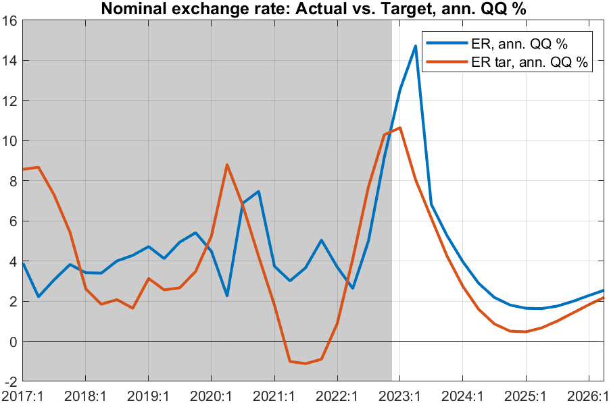
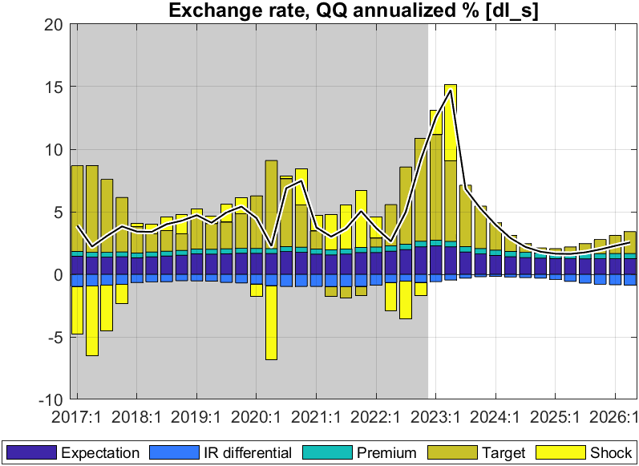
Forecast—Nominal exchange rate (ER)
Exchange rate policy “rule”
mainly driven by nominal ER target, expectations, and somewhat by domestic-foreign interest rate differentials.
ER target driven by trend RER depr. rate (0%) and inflation differential (2%)
ER policy reflected in forecast:
reflects NBR’s flexible ER policy, and hybrid rule:
ER steered toward target ER so that RER gradually falls in line with its target or trend depreciation rate
some response to domestic-foreign interest differentials
in 2023, before ER steered back to target
trend depreciation rate converges to 3% p.y.

Slide 26
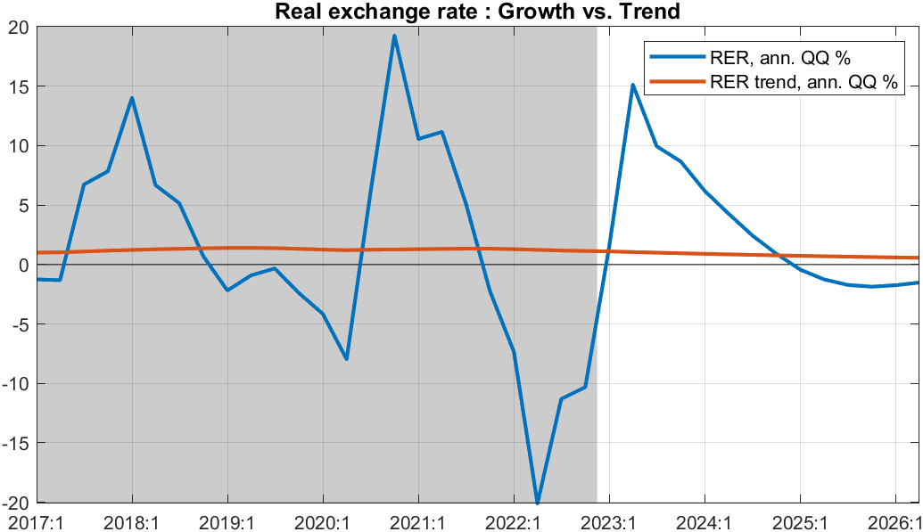
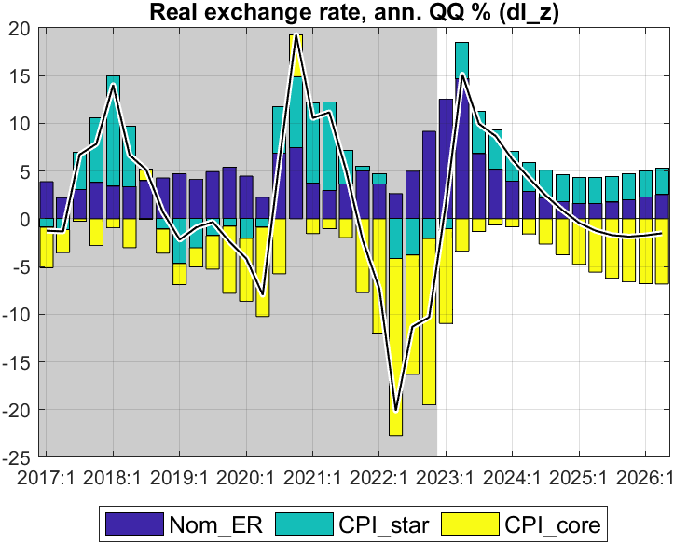
Forecast—Real exchange rate (RER, q-on-q change annualized)
RER components
after sharp decline in RER since Q3 2021 as core inflation surged,
RER is forecast to increase from Q2 2023 on for several quarters
before returning to its trend (0%), with some temporary undershooting
RER results from ER, CPI_core and foreign CPI
forecast to switch from real appreciation in 2022 and early 2023 to real depreciation from mid-2023
returning toward trend RER depreciation rate (0%) thereafter
pull-down effect on demand (from RER appreciation in most of 2022) becomes pull-up from 2023 on as RER returns to trend
Notes:
Seeming overshooting of RER (then some undershooting) desirable? Can it smoothened

Slide 27
Summary of policy stance and forecast outlook
Policy stance underlying the forecast
maintenance of recently increased policy interest rate (tuned for 2023Q2)
somewhat faster rate of exchange rate depreciation in 2023 (tuned for 2023Q1)
reduction fiscal deficit (before grants) to 12% of GDP in 2023Q1-2, then to 9.6% in 2023/24 (both tuned), then return to sustainable level of around 11% of GDP (unlike PCI, much lower deficit path through 2030)
positive fiscal stance—2% of GDP on average in 2019/20-2021/22—replaced by negative stance from 2022/23, then positive again in 2024/25 as deficit returns to sustainable level
Forecast of key macro indicators
RIR forecast to rise (albeit from a low negative level) and exert less upward pressure on private demand
RER forecasted to have faster depreciation and affect positively domestic demand (and trade balance G&S)
Headline inflation (peaked in Q4 2022) forecast to decline gradually in 2023 as food and energy prices are forecast to continue falling from their peaks in 2d half of 2022; and to be close to 5% target from 2024
GDP growth forecast to pick up to average 8.5% in 2023-24 before returning to its trend of 7.5% annually
Output back to potential as low (albeit rising) RIR and rising (of albeit still low) RER, keep demand up; this is countered in 2022/23-2023/24 by temporarily lower deficit, and output is back to potential only in 2026
Issue: address volatility (govt demand, output, inflation…) by smoothen govt deficit closer to sustainable level ?
Notes:
Both RIR and RER return gradually to their steady states of RIR of 2.5% and RER depreciation rate of 0%. (or is it 2% ie rstar 0%+country premium 2% CHECK). Should rstar_ss be raised to 0.5%?)

Slide 28
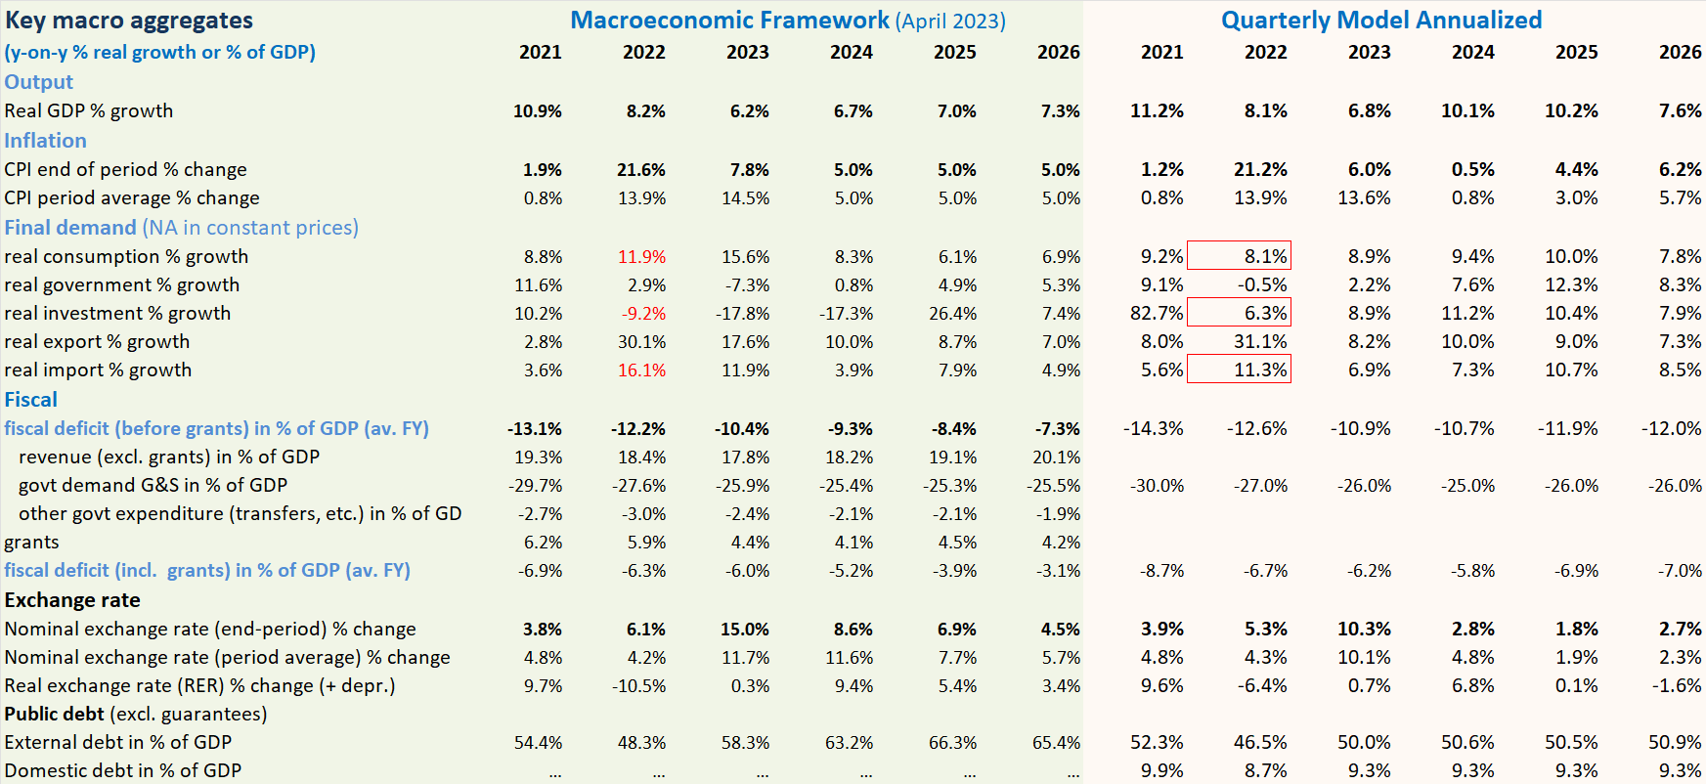
Comparison with Macro Framework

Slide 29
Comparison with Macroeconomic Framework (MF)
Illustrative comparison with April 2023 projection (PCI-RSF)
compared to MF, the annualized QMFM result has:
lower volatility in final demand components, especially for consumption, investment and imports (MF needs consumption-savings checks)
lower average CPI inflation in 2023-24, as QMFM captures the impact of the large negative fiscal stance
lower ER depreciation from 2024, as it forecast zero RER depreciation in medium term
(MF has real depreciations each year in 2024-26, over 20% cumulatively; cp. to QMFM 6%)
higher fiscal deficits from CY 2024—returning to sustainable level--while MF-PCI has deficit much below that for 5 years

Slide 30
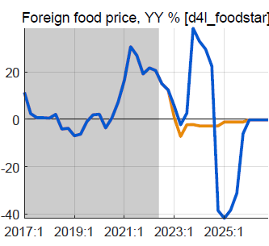
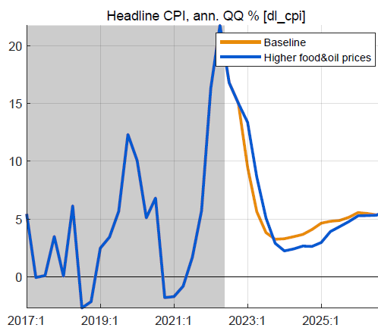
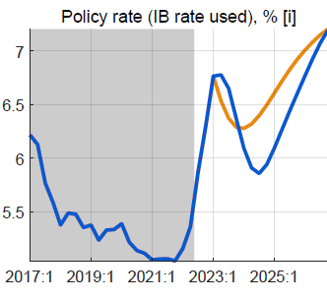
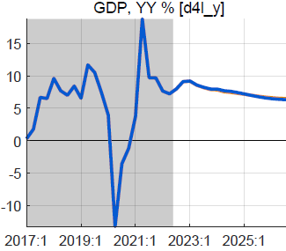
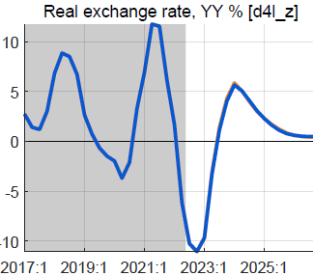
Alternative scenario: higher foreign food/oil prices (2023-24)
Higher-than-WEO foreign food and oil prices in 2023-24
foreign food and oil prices on average 25% higher than BL
with peak around end-2023, return to WEO levels from 2025
no change in fiscal policy
Results in higher headline CPI, little or no effect on output
headline CPI temporarily higher, reflecting food/oil import shares
small response policy rate, reversed fast as expected inflation drops
small positive effect on demand of lower RIR
mostly offset by negative effect of slightly more appreciated RER
overall effect on GDP is very small, less than 0.2%

Slide 31
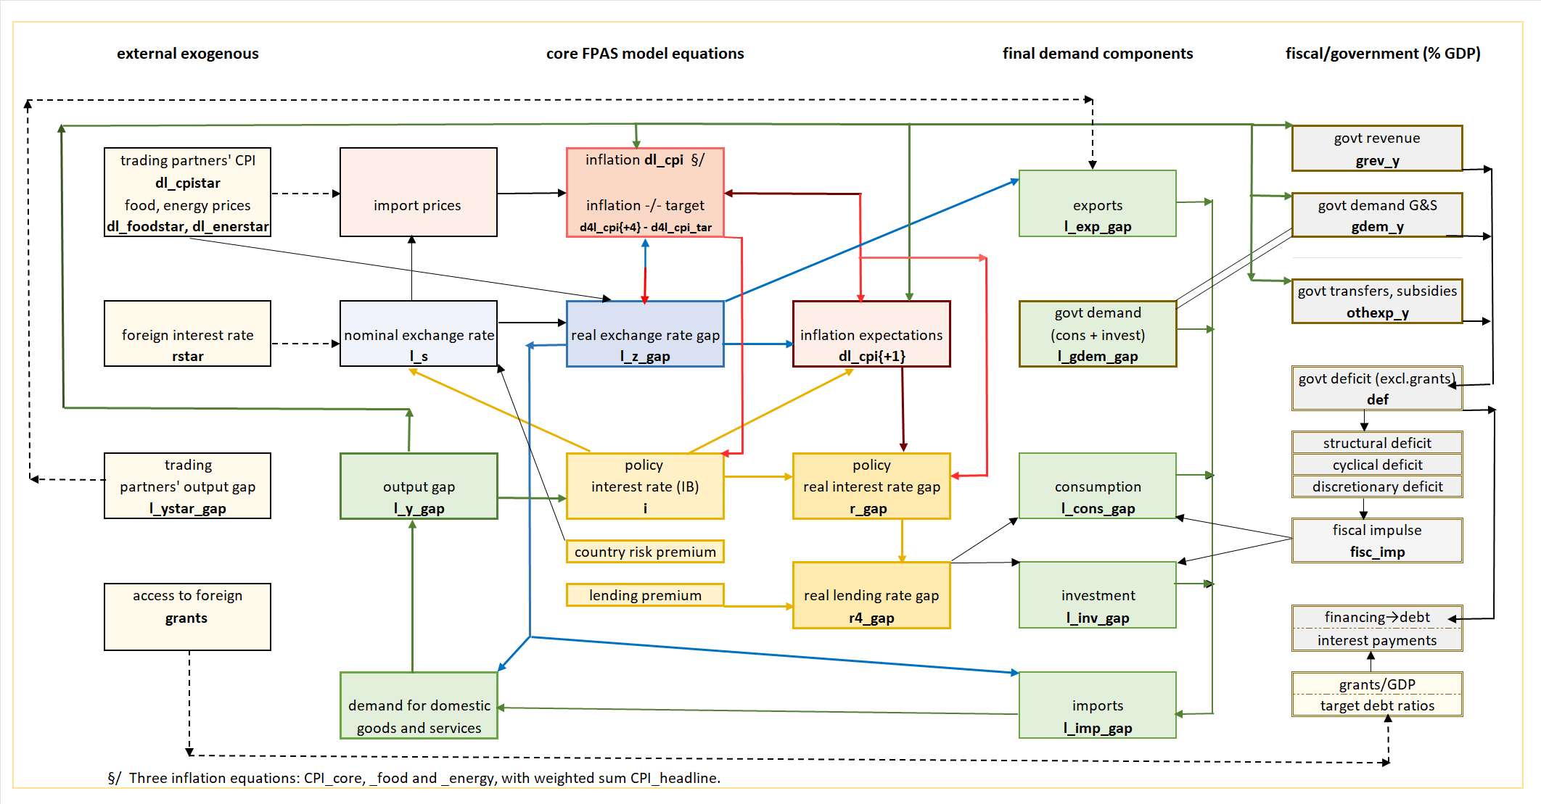
QMFM: main relationships and transmission mechanisms

Slide 32
THANK YOU

